Slide 1
Employee Salary Prediction Using ML
CAPSTONE PROJECT
Presented By:
Maithilee Kadam — SITCOE Yadrav — CSE Department

Slide 2
OUTLINE
Problem Statement (Should not include solution)
System Development Approach (Technology Used)
Algorithm & Deployment (Step by Step Procedure)
Result
Conclusion
Future Scope(Optonal)
References

Slide 3
Problem Statement
In today’s data-driven world, predicting employee salaries based on multiple factors is critical for HR analytics.
Existing systems lack real-time interactive prediction tools.
Manual analysis of salary trends is time-consuming and inefficient.
There is a need for a smart web-based solution that predicts salaries using historical data.
Our project addresses this gap with a machine learning model deployed using a web interface.

Slide 4
System Approach
Technologies Used: Python, Streamlit, Scikit-Learn, Pandas
System Requirements:
Python 3.x
Streamlit Library
Scikit-learn Library
Pandas, NumPy for data handling
Frontend: Streamlit-based Web UI
Backend: Random Forest Regression Model

Slide 5
Algorithm & Deployment
Collect and clean employee dataset
Encode categorical variables using LabelEncoder
Train Random Forest Regressor model with historical data
Deploy model on Streamlit with user inputs (age, education, workclass, etc.)
Predict and display salary on the web interface
Allow users to download results as CSV

Slide 6
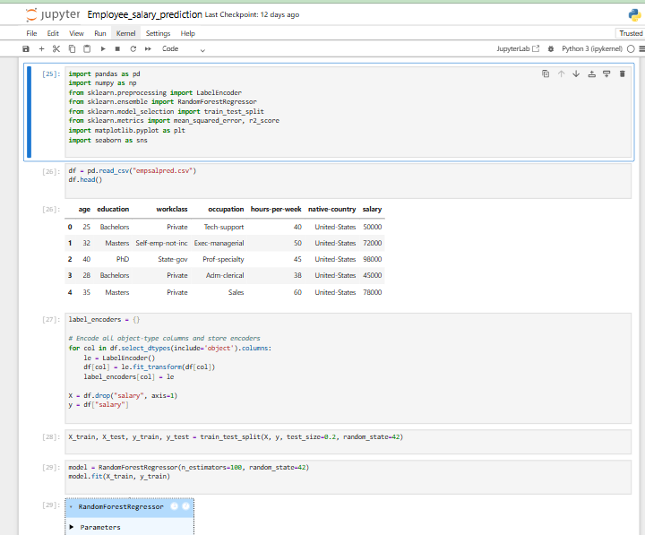
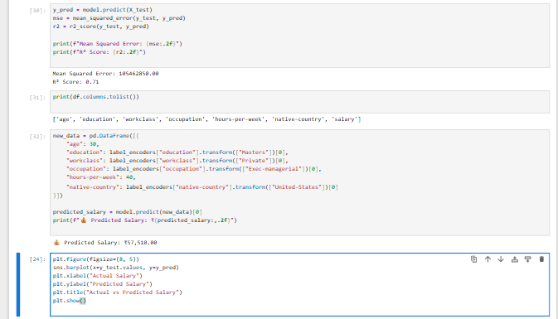
Result

Slide 7
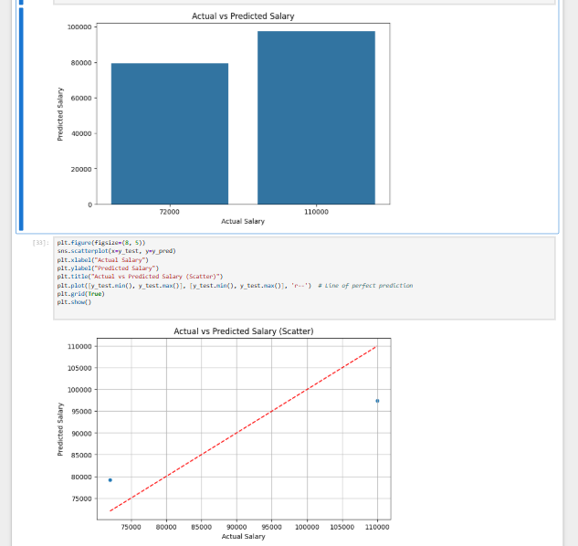
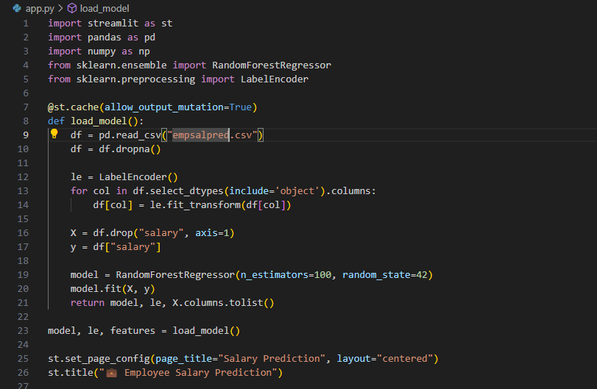

Slide 8
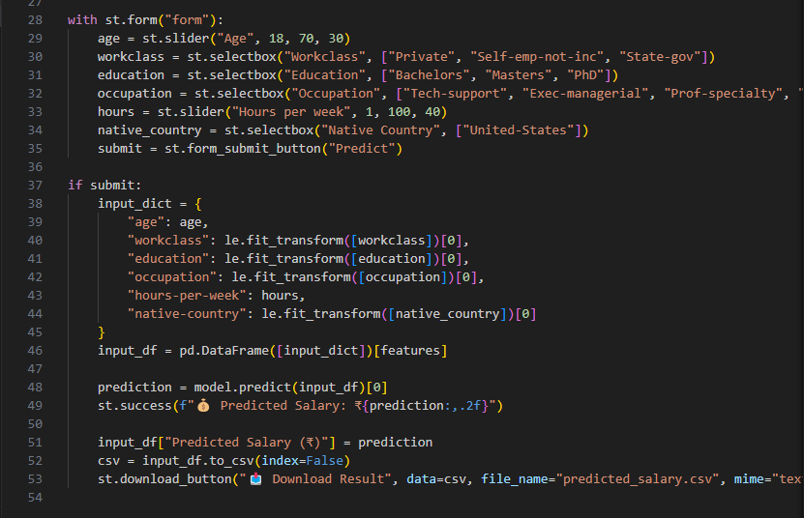
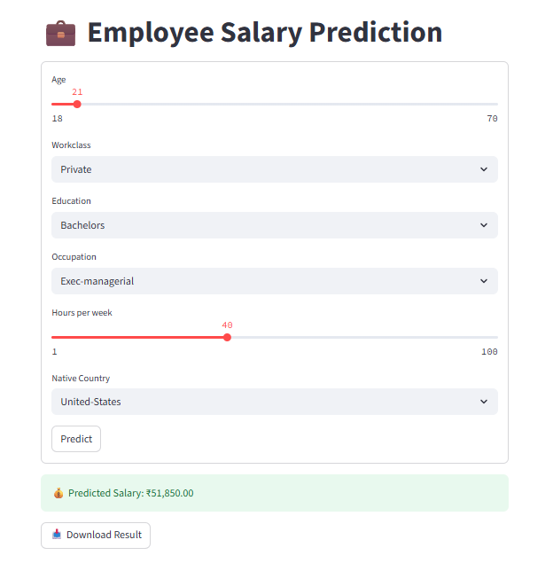

Slide 9
Conclusion
The project demonstrates accurate salary prediction using machine learning
Provides an interactive tool for HR & employers
Deployment on Streamlit ensures easy accessibility
Model performs efficiently on encoded dataset with Random Forest Regressor

Slide 10
Future scope(Optional)
Integration with larger datasets across industries
Adding more features like experience, certifications
Deploying on cloud platforms for broader accessibility
Incorporating visualization dashboards for trend analysis

Slide 11
References
Scikit-Learn Documentation
Streamlit Official Docs
Kaggle Datasets for Salary Prediction
Project Repository: GitHub Link

Slide 12
THANK YOU

